Slide 1
MRA Project - MileStone 1
RITUSRI MOHAN

Slide 2
CONTENTS
PROBLEM STATEMENT
DATA DICTIONARY
EDA
UNIVARIATE ANALYSIS
BIVARIATE ANALYSIS
MULTIVARIATE ANALYSIS
EDA INFERENCES
RFM ANALYSIS
RFM ANALYSIS & CUSTOMER SEGMENTATION
CUSTOMER SEGMENTATION : BEST CUSTOMERS
CUSTOMER SEGMENTATION : LOYAL CUSTOMERS
CUSTOMER SEGMENTATION : RISKY CUSTOMERS
CUSTOMER SEGMENTATION : LOST CUSTOMERS
RFM INFERENCES

Slide 3
PROBLEM STATEMENT
An automobile parts manufacturing company has collected data of transactions for 3 years. They do not have any in-house data science team, thus they have hired you as their consultant. Your job is to use your magical data science skills to provide them with suitable insights about their data and their customers.
Copy -Paste the Link to the Tableau Workbook:
https://public.tableau.com/app/profile/ritusri.mohan/viz/MRAProject-Milestone1_16556457578490/RiskyCustomerschurning

Slide 4
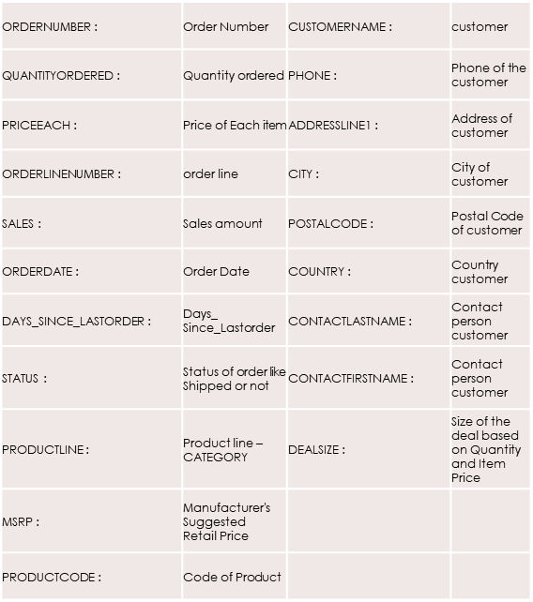
DATA DICTIONARY

Slide 5
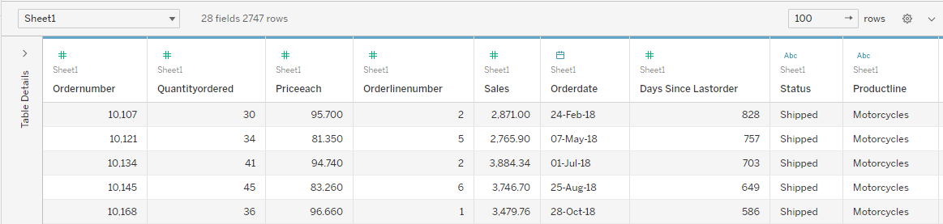
EXECUTIVE SUMMARY OF DATA
The excel file was uploaded on Tableau and explored.
There are 2747 rows and 20 columns.
There are no null values

Slide 6
EDA ANALYSIS IN TABLEAU
Univariate Analysis
Bivariate Analysis
Multivariate Analysis

Slide 7
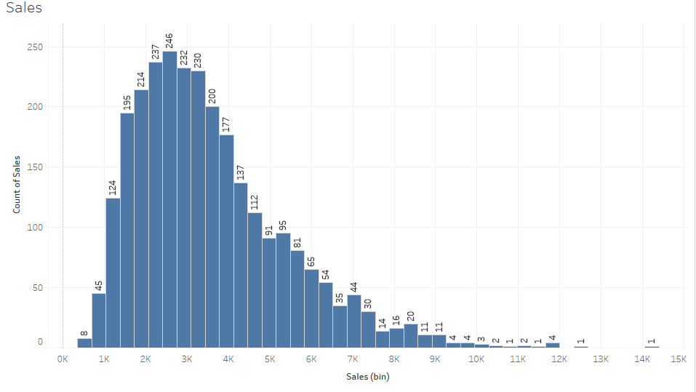
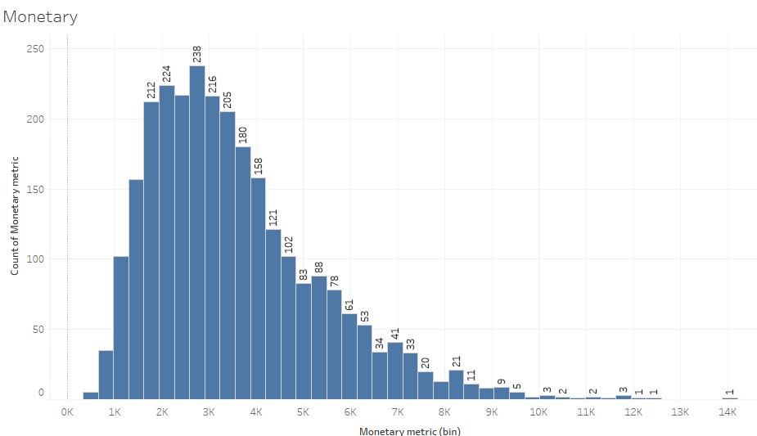
Univariate Analysis
Sales
Monetary
The numeric variable Sales & Monetary are nearly same slightly right skewed bell curve

Slide 8
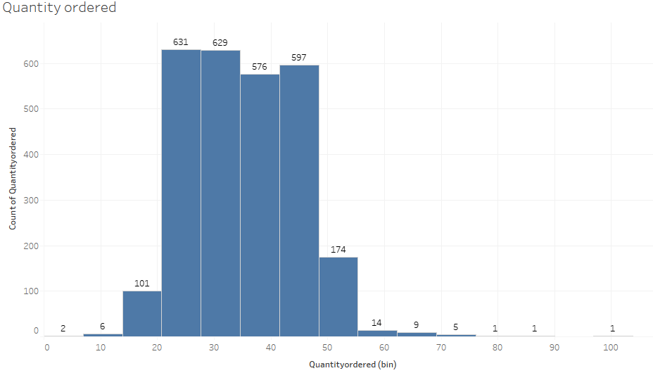
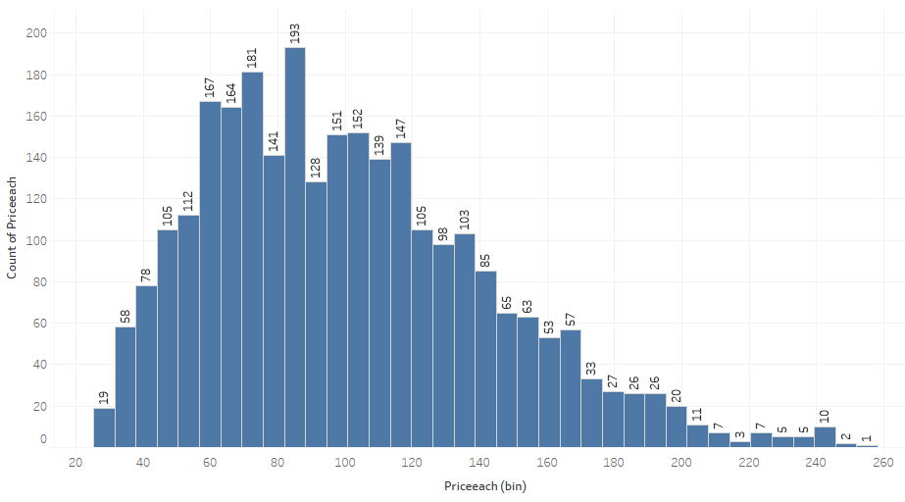
Univariate Analysis
Quantity ordered
Price each
The numeric variable Quantity ordered & Price each have both very high and low values.

Slide 9
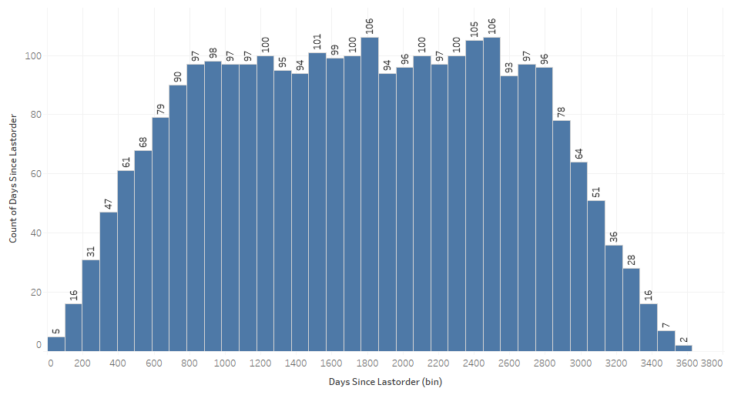
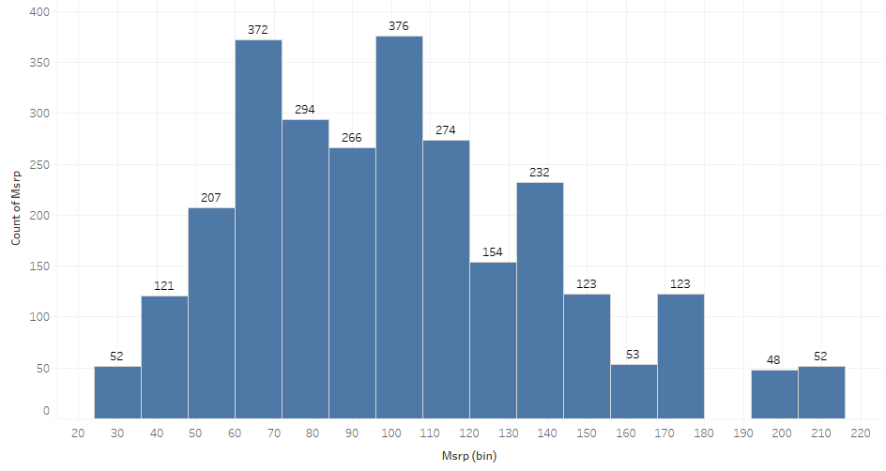
Univariate Analysis
Days since last order
MSRP
In the Days since last order plot, customers have a range of 800-2800 days of last orders.

Slide 10
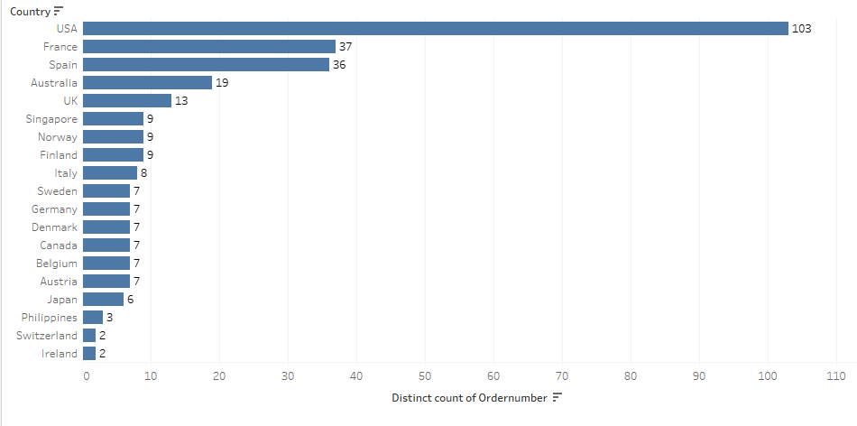
Bivariate Analysis
Orders by Country
It can be seen that the maximum number of orders are from the USA, followed by France, Spain and so on.

Slide 11
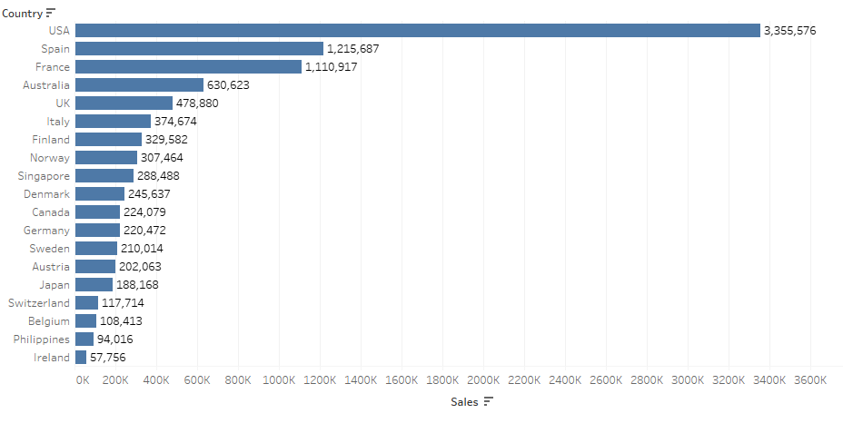
Bivariate Analysis
Total sales by Country
It can be seen that the maximum number of sales are from the USA, followed by Spain, France and so on.

Slide 12
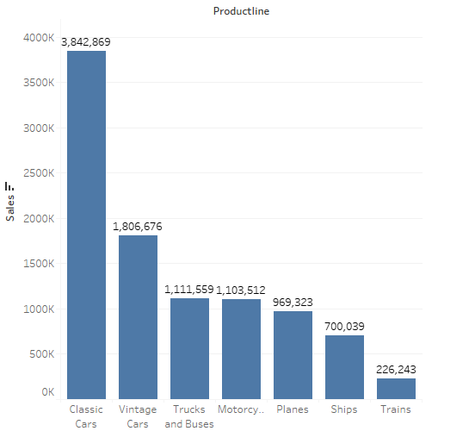
Bivariate Analysis
Sales across Product lines
It can be seen that the maximum number of sales are in the ‘Classic Cars’ category, followed by ‘Vintage Cars’ , ‘Trucks & Buses’ and so on.

Slide 13
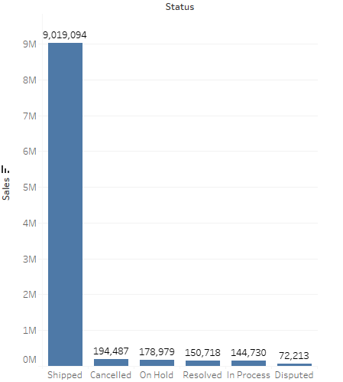
Bivariate Analysis
Order Status and Sales
It can be seen that maximum sales revenue is generated from the order status-‘Shipped’, followed by ‘Cancelled’, ‘On Hold’ and so on.

Slide 14
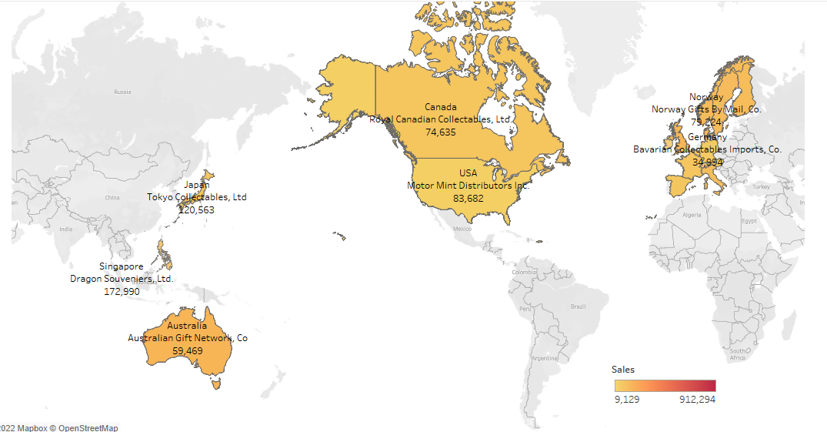
Multivariate Analysis
Sales & Customer names in various Countries
In the map, sales and customer names in various countries can be seen.

Slide 15
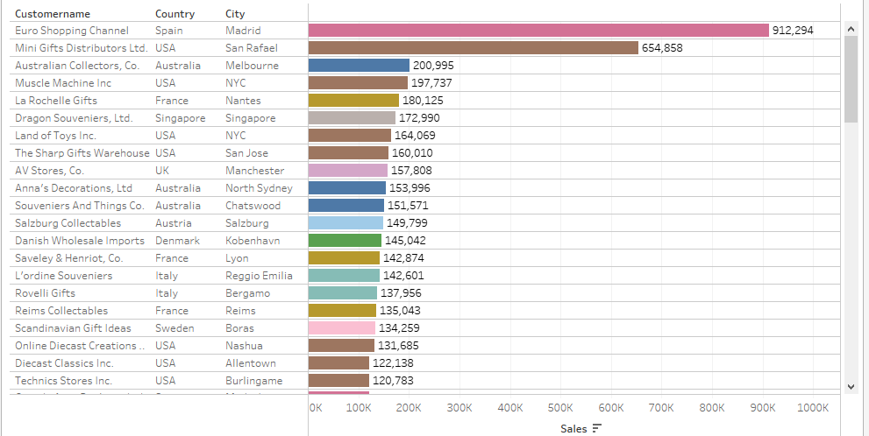
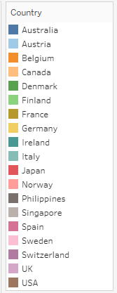
Multivariate Analysis
Sales & Customer names in various Countries & City

Slide 16
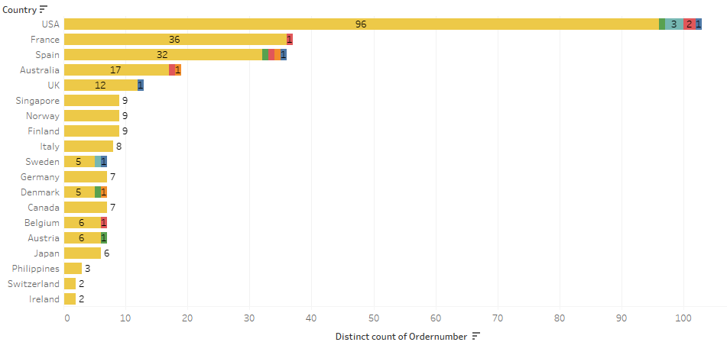
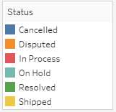
Multivariate Analysis
Order Status of order numbers by Countries
It can be seen that USA has most number of shipped orders with 3 on hold, 2 in progress and 1 cancelled.

Slide 17
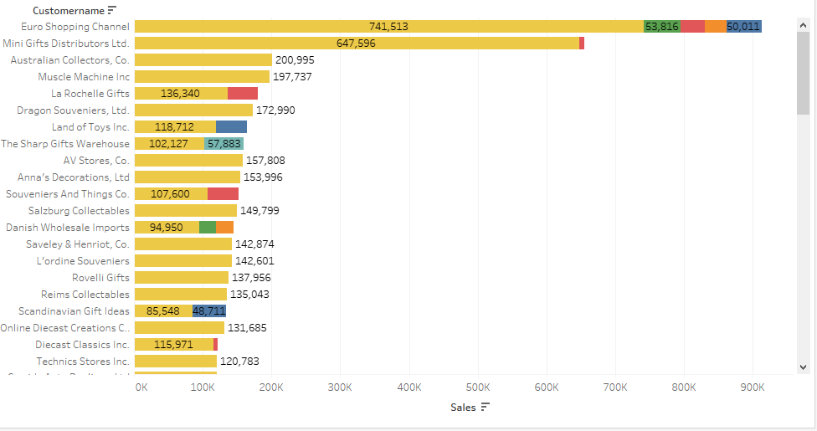
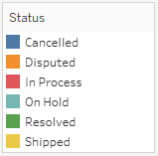
Multivariate Analysis
Order Status of order numbers by Countries
The customer with the largest sales and orders dispatched is Euro Shopping channel, followed by Mini Gifts Distributers ltd. Another indication for the corporation to check is if Euro Shopping Channel has orders that are in the position of being cancelled or disputable.

Slide 18
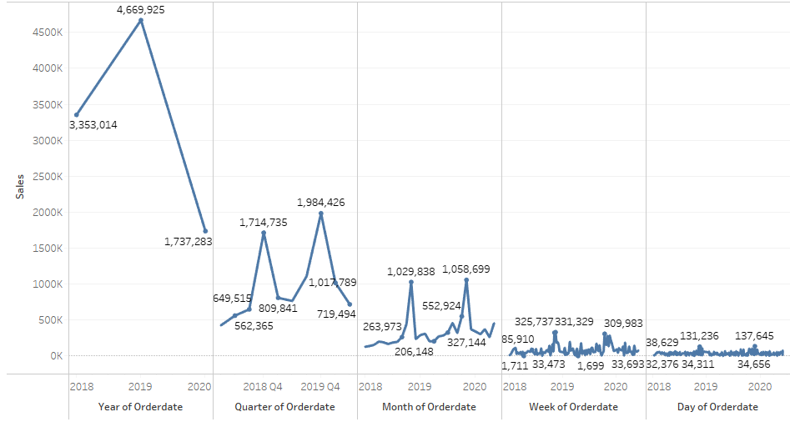
Trends of Sales
Sales as per Time period
It can be seen that sales shoot up from 2018 to 2019 and then fall to a great extent in 2020.
Quarterly and Monthly sales follow a trend with seasonality.

Slide 19
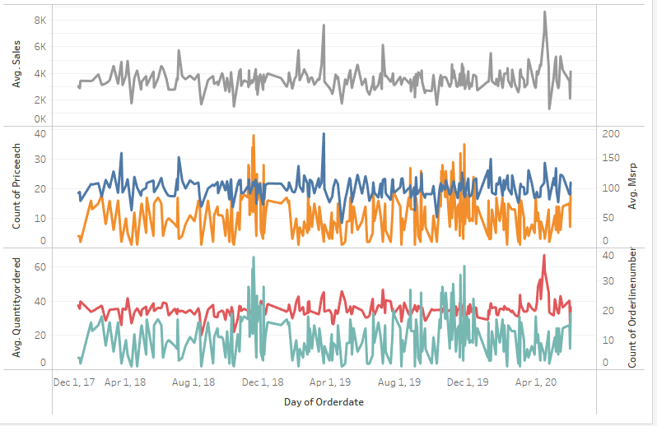
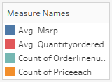
Trends of Sales
Day Trend of Sales

Slide 20
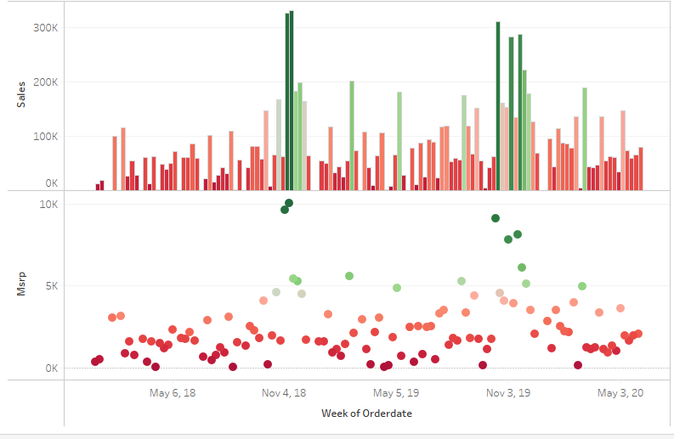

Trends of Sales
Weekly Trend of Sales & MSRP

Slide 21
EDA INFERENCES
The sales of classic cars appear to be the largest, while those of trains are the lowest.
Compared to small and large deals, medium deals typically result in substantially higher sales.
In terms of sales volume, Euro Shopping Channel appears to be the best client.
The most popular items overall for both buying and selling are classic cars.
Compared to other countries, the USA has the biggest sales.
Spain's capital city Madrid produces the most sales compared to other cities.
It might be assumed that the corporation should concentrate on obtaining large size chunk projects as sales of large size deals have essentially remained flat throughout the years.

Slide 22
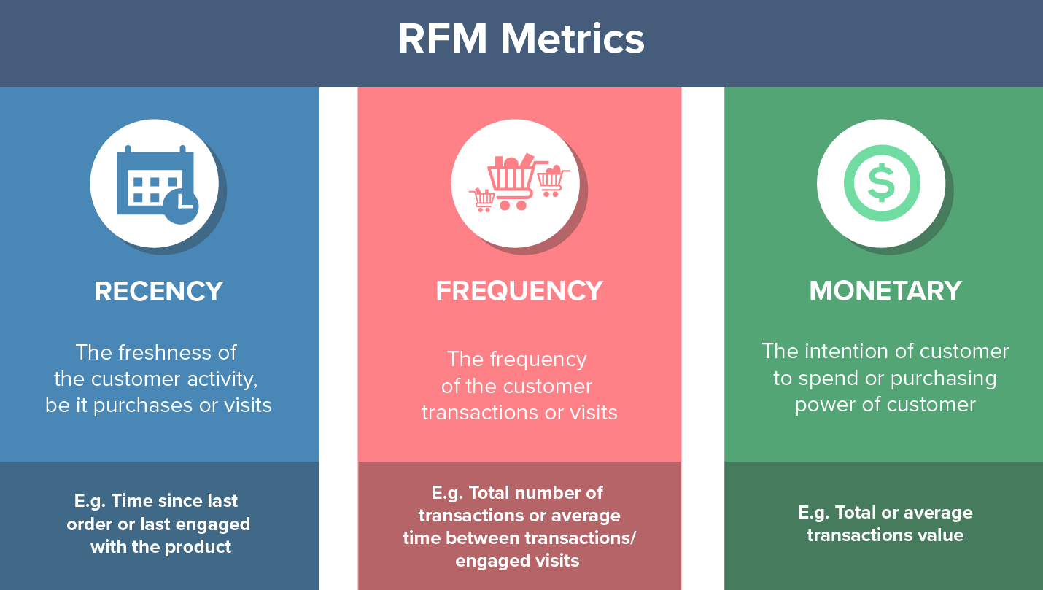
RFM ANALYSIS
The “RFM” in RFM analysis stands for recency, frequency and monetary value. RFM analysis is a way to use data based on existing customer behavior to predict how a new customer is likely to act in the future. An RFM model is built using the RFM metric:

Slide 23
RFM ANALYSIS
Each of the RFM metrics, i.e., Recency, Frequency and Monetary were divided into 4 categories
Customer segmentations were done as per various combinations of the 4 categories of the RFM metrics.
The various customer segments are:
High: H
Medium: M
Low: L
Very Low: VL
Platinum which represents Best Customers
Diamond which represents Loyal Customers
Gold which represents Risky Customers (on the verge of churning)
Silver which represents Lost Customers

Slide 24
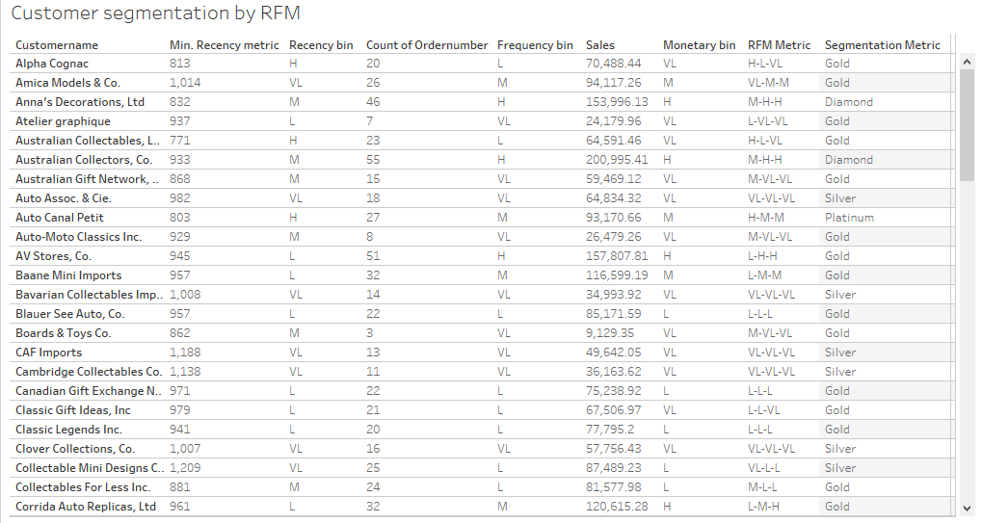
RFM ANALYSIS & CUSTOMER SEGMENTATION

Slide 25
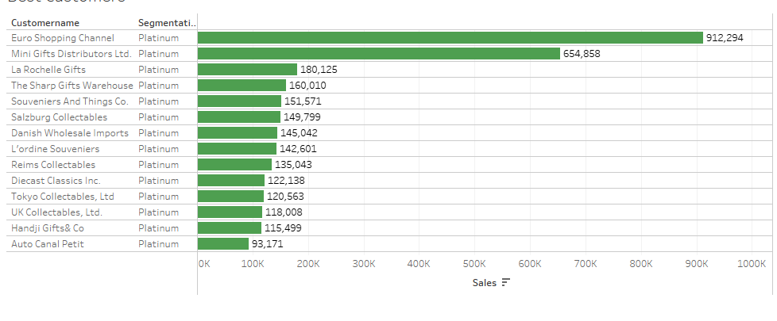
CUSTOMER SEGMENT: BEST CUSTOMERS

Slide 26
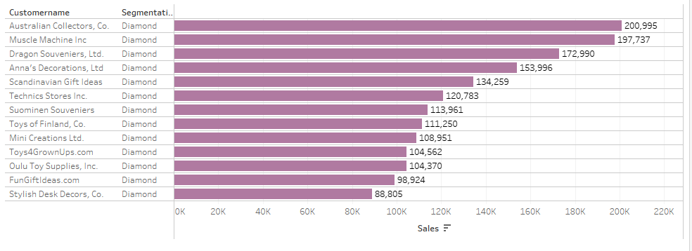
CUSTOMER SEGMENT: LOYAL CUSTOMERS

Slide 27
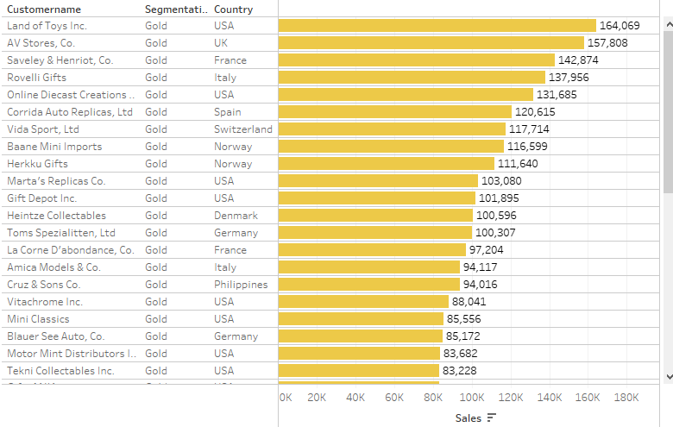
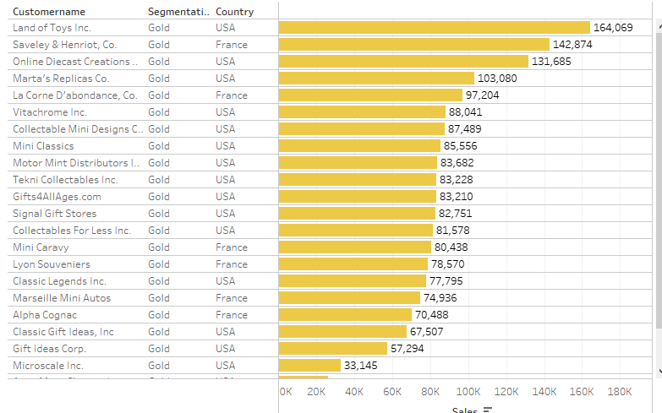
CUSTOMER SEGMENT: RISKY CUSTOMERS
Max Risky Customers

Slide 28
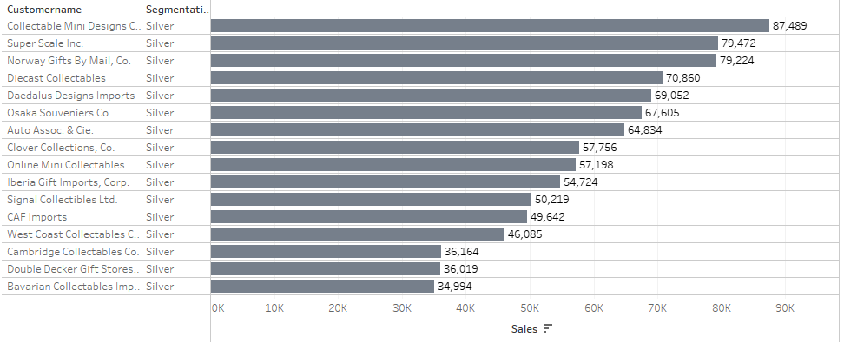
CUSTOMER SEGMENT: LOST CUSTOMERS

Slide 29
RFM INFERENCES
Best and Loyal customers bring in decent revenue. Services can be same or improved in order to continue business with them
There are a high number of Risky customers which have the potential to bring in great revenue. In order to increase the frequency of the sales with them, additional services can be introduced.
Maximum Risky customers are from USA & France. It would be beneficial for business if shipping concerns for these nations could be managed better.
There is nothing that can be done about Lost customers.

Slide 30
THANK YOU

